Slide 1


Analysis on the impact of coronavirus on market capitalization of S&P500 companies Group 003-001 Ricardo Calleja Jose CALLE Toro Patricio Ramirez Cristian Salinas
St. Clair College Fall 2022

Slide 2
CONTENTS
Background / Motivation
Problem statement
Project description
Analysis questions
Method
Results

Slide 3

01.
Background / Motivation.

Slide 4

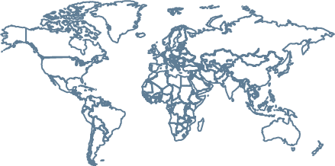
Background / Motivation.
Pandemics are recurrent (Ex. Ebola 2013, Spanish flu 1918), and they had an economic impact. The rise of economic uncertainty during Covid-19 pandemic (Ortmann et al., 2020), increased investment risk. Understanding the trend of economic actors, could be used as a comparison for similar events in the future.
Disclaimer: Even though investment risk augmented during COVID-19, it is not our intention to assure causation.

Slide 5
Background / Motivation.
Since COVID-19 pandemic was officially declared in January 2020, the period of the year 2020 with respect to 2019 will be referred as “before” the pandemic, and for the year 2021 with respect to 2020 will be called “after” the pandemic. Considering seasonality effects, the analysis is performed on a quarterly basis.

Slide 6
Background / Motivation.
S&P500 Index or Standard & Poor's 500 Index, is considered a point of reference to compare the economic trends. It comprises around 500 leading publicly traded companies in the U.S. divided by GICS sector (Global Industry Classification Standard).

Slide 7
02.
Problem STATEMENT

Slide 8

”
Investors in S&P500 index need to understand tendencies on market capitalization before, and after pandemics, in order to use it as a point of comparison for similar events in the future.
*Before refers to all quarters of 2019. *After refers to all quarters of 2021.

Slide 9
03.
pROJECT description

Slide 10

PROJECT DESCRIPTION
We created a descriptive analysis to comprehend the market capitalization variation of the companies and sectors that belong to the S&P500 index, before and after COVID-19, considering seasonality effects we segregated the time period also by quarters.

Slide 11
04.
Analysis Questions

Slide 12

1) WHAT GICS sectorS in the S&P500 index performed THE BEST in market capitalization variation TERMS, BEFORE and after the pandemic? 2) WHICH WAS THE TOP COMPANY in the S&P500 index WITH HIGHER POSITIVE MARKET CAPITALIZATION FOR each quarter BEFORE and after the pandemic?

Slide 13
05.
METHOD

Slide 14
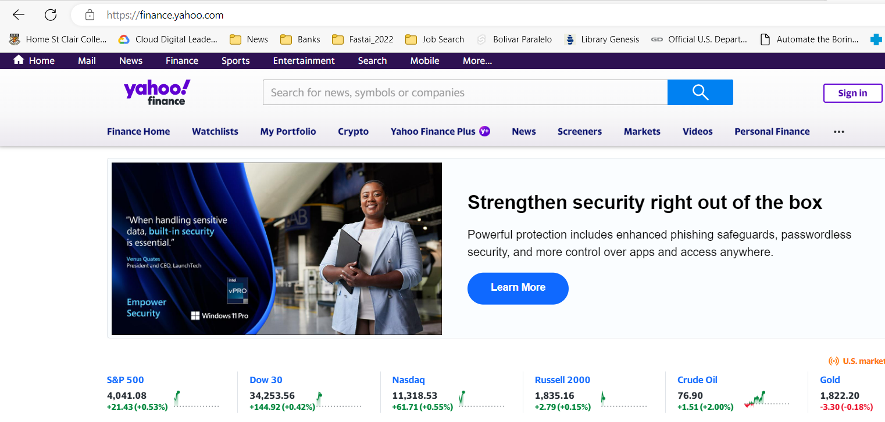
METHOD
1) The dataset to be used comes from Yahoo Finance API and it includes stock price, share quantity and a description of each company within the S&P500.
2) It covers all quarters from 2019, 2020 and 2021.

Slide 15

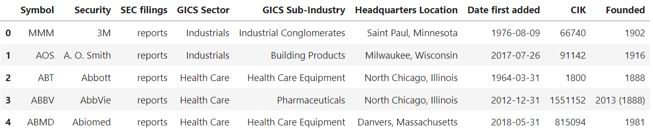
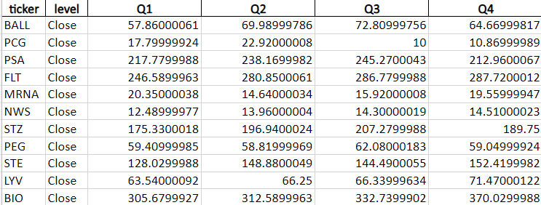
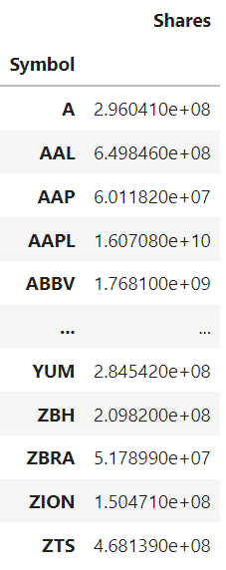
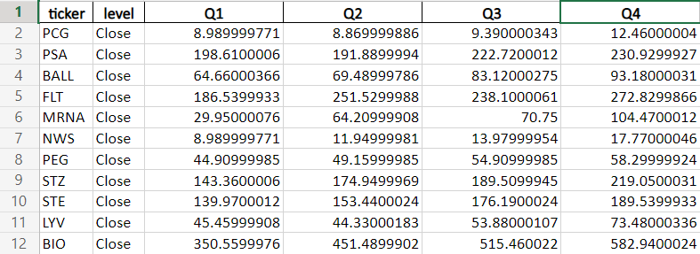
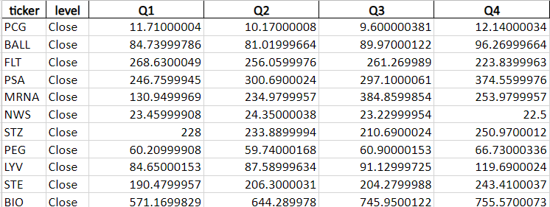
1
2
3
Merged datasets:
Dataset #1 - List of SP500 companies Dataset #2 - Q1-Q4_2019
Dataset #3 - Q1-Q4_2020
Dataset #4 - Q1-Q4_2021
Dataset #5 - Shares companies
5
4

Slide 16

METHOD
Merge Dataset
Clean Database
ANALYZE Database
Visualizations
1
2
3
4
Consolidate the datasets: S&P500 companies, Shares S&P 500,.
Analyze the data before coming to any assumption
TABLEAU DASHBOARD
Clean the data that can generate negative effects on the final result

Slide 17
METHOD
For each company of the S&P500 index we joined the data for the year 2019, 2020 and 2021 by quarters. After this, Market capitalization was calculated (Share price times Share Volume). Additionally, we found Market capitalization variation for the period 2020 vs 2019 and 2021 vs 2020. Finally, the data was also analyzed by GICS sector.

Slide 18
06.
Exploratory Data Analysis (EDA)

Slide 19
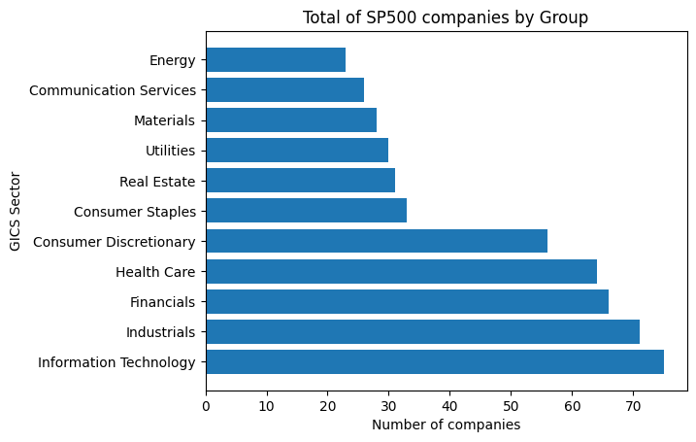
Exploratory Data Analysis
S&P500 index is composed by 503 companies, divided on 11 Sectors, Lead by Information Technology, Industrials and Financial companies.

Slide 20
06.
Results

Slide 21
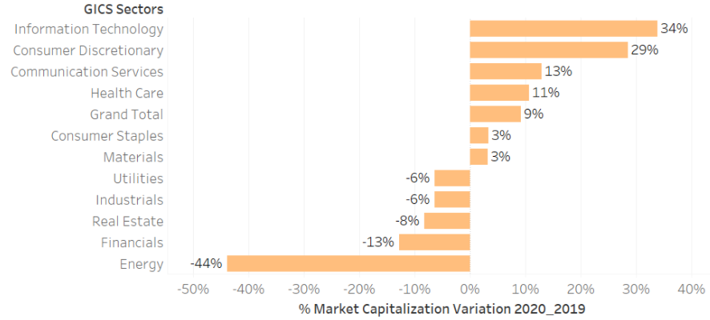
1) WHAT GICS sectorS in the S&P500 index performed THE BEST in market capitalization variation TERMS, BEFORE THE pandemic?
FOR THE PERIOD 2020 WITH RESPECT TO 2019, the GICS sector in the S&P500 index with higher positive variation on market capitalization WAS INFORMATION TECHNOLOGY with 34%.

Slide 22
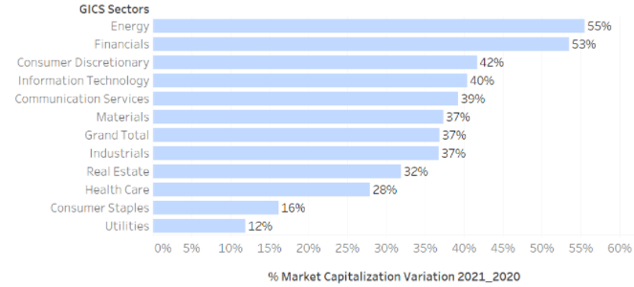
1) WHAT GICS sectorS in the S&P500 index performed THE BEST in market capitalization variation TERMS, AFTER THE pandemic?
FOR THE PERIOD 2021 WITH RESPECT TO 2020 the GICS sector in the S&P500 index with higher positive variation on market capitalization WAS ENERGY with 55%.

Slide 23
2) WHICH WAS THE TOP COMPANY in the S&P500 index WITH HIGHER POSITIVE MARKET CAPITALIZATION FOR each quarter before and after the pandemic?
ENPH = Enphase
TSLA = Tesla
BBWI = Bath & body works
MRNA = Moderna
DVN = devon energy

Slide 24

08.
conclusions

Slide 25
CONCLUSION
As we could see the S&P500 has companies that presents activities in 11 different sectors. The sector with the most presence is information technology, followed by industrials and financials. On the contrary, energy is the sector with the fewest number of companies operating in this index.
Regarding the sector that could be highlighted in the market capitalization for the periods 2019-2020, and 2020-2021, we can observe that:
1- For the year 2020, concerning the previous year, the information technology sector was the one that led the list, followed by consumer discretionary and communication on services; the first with 34%, the second with 29%, and the third with 13% increase. On the other hand, the sectors that decreased the most were Real Estate (8%), financials (13%) and energy, with a negative 44%.

Slide 26
CONCLUSION
2- The variation of the year 2021 concerning the previous year, all sectors had positive market capitalization variation, led by energy, financials and consumer discretionary; the first with 55%, the second with 53% and the third with 42% respectively. It should be noted that for this year, most countries began to open borders and reactivate their economy, and it could be seen reflected in the growth and improvement of these companies in economic sectors.
It should be noted that the companies that had a negative effect in 2020 compared to 2019, for the year 2021, had a noticeable growth and recovery; such is the case with the Utilities, Industrial, Real Estate, Finance and Energy sectors.

Slide 27
CONCLUSION
Additionally, when comparing the companies that had the best results by quarter, we were able to observe that Tesla was the company that stood out the most among the periods studied, since by 2020, it was the company that grew the most among the quarter 2 and quarter 4, besides, for the following year, it was the company with the greatest positive variation for the first quarter.

Slide 28
RECOMENDATIONS
According to what was previously observed in our analysis of the impact of coronavirus on the market capitalization of S&P500 companies, we can recommend to investors that in the event of events of similar characteristics to the Covid-19 pandemic the following:
1- Do not lose control due to temporary losses. The biggest recoveries usually happen right after big falls.
2- Diversification is a fundamental element of investments. By diversifying an investment it is possible to mitigate or minimize the risks.

Slide 29
REFERENCE
1- Ortmann, R., Pelster, M., & Wengerek, S. T. (2020). COVID-19 and investor behavior. SSRN Electronic Journal. https://doi.org/10.2139/ssrn.3589443

Slide 30
Analysis on the impact of coronavirus on market capitalization of S&P500 companies Group 003-001 Ricardo Calleja Jose Toro Patricio Ramirez Cristian Salinas
St. Clair College Fall 2022

